Slide 1
Endpoints Operations
Monthly Operations Summary
JL IT
October 2022

Slide 2
Executive Summary
Incident Management saw incident volume remain steady in September (3,325). The first call resolution, or FCR, was 85.4%. The overall SLA goal across all teams was met at 90.7%.
Service Desk call volume remained largely the same at 2,800 in September. Calls answered within 30-, 60-, and 90- seconds goals were surpassed. Average speed to answer was 33 seconds. The abandonment rate goal for the month was also surpassed at 4.8%. SLA goals were met by the Service Desk with an overall SLA score of 97.5%.
Technology Operations assignment groups opened or received 437 incidents across the month. Critical Alerts increased to 289 in September. We still need to work on fine-tuning Logic Monitor thresholds and make sure Jackson Lewis and third parties are putting equipment in SDT mode to avoid false positive outages.
Endpoint Engineering Successfully moving through our test regimes(JL Core, JL Pilot) using Company Portal as primary deployment agent. Finalizing plans for Egress, Litera, Kofax and Netdocs to deploy to majority of the firm by years end. Troubleshooting and resolving issues found in Autopilot/AAD joined devices as SMEs are testing workflows for their specific roles. CIS Policies are currently in pilot and we're monitoring any issues/workflow blocks that these could cause.
Endpoint Projects NextGen was put on hold in September. Self Service Password Reset is currently being patched on the domain controllers. We are awaiting confirmation before rolling it out nationwide. Final amenities form for the Conference Room project was updated and configured in our test environment. Working with Microsoft on getting all rooms to show up in the Outlook Roomfinder before training the OA’s and department managers.

Slide 3
Incident Management Summary
Service Desk Summary
Technology Operations Summary
Endpoint Engineering Summary

Slide 4
Incident Management

Slide 5
Incident Statistics
3,534 incidents were opened during the month, across all groups within SNOW. 19% of incident volume were emails.
Phone: 2760
Email: 672
Self-Service: 77
Walk-in: 23
First contact resolution lowered slightly in October to 83.8% (as opposed to 85.4% in September).

Slide 6
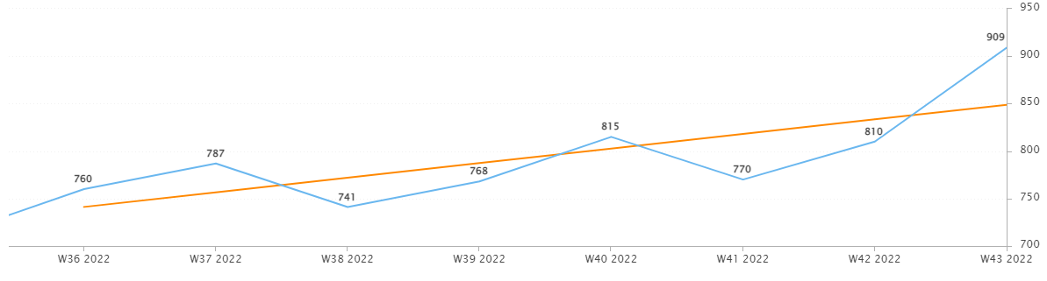
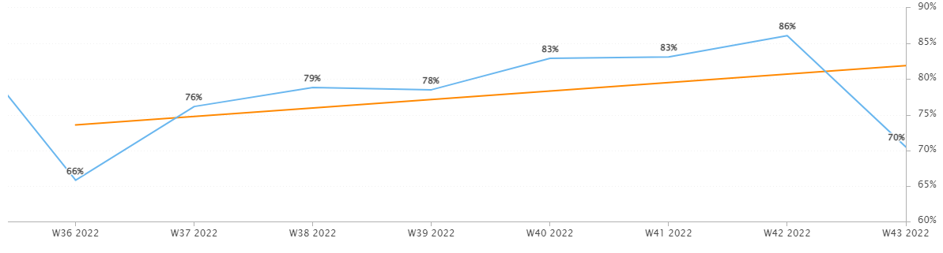
Incident Statistics
Incidents Opened by Week
Incidents opened by week continued to trend upward.
The percentage of incidents resolved the same day that they were opened trended upward in October.
Percentage of incidents resolved; same day opened.

Slide 7
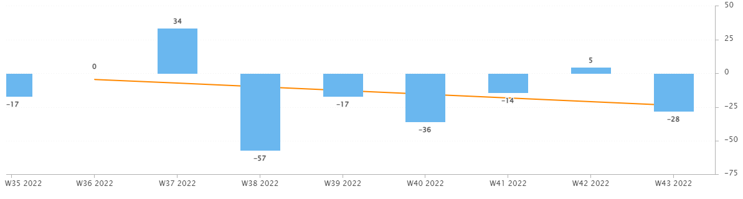
Incident Statistics
Open Incident Backlog Growth
In October, backlog growth continued to trend downward. Reminders sent regarding oldest incidents helped push teams to close their older incidents.
Notes:
Backlog growth is a way of answering, “did we end the week with more or less incidents?”.

Slide 8
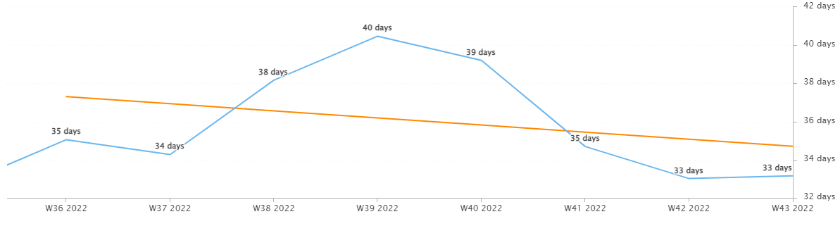
Incident Statistics
Average Age of Open Incidents
In October, the average age of open incidents trended downward.
Notes:
Please remind your teams to continue to work on their open incidents- this affects many of the previous slides as well as this one.

Slide 9
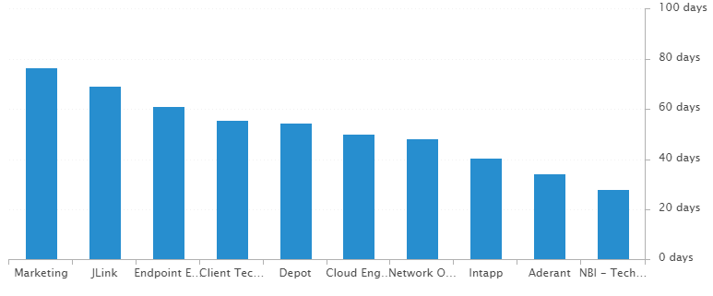
Incident Statistics
Average Age of Open Incidents by Assignment Group - as of the last day of the month

Slide 10
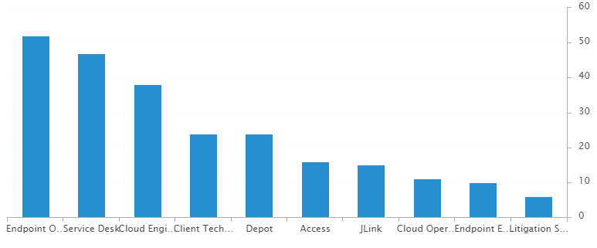
Incident Statistics
Open Incidents by Assignment Group - as of the last day of the month

Slide 11
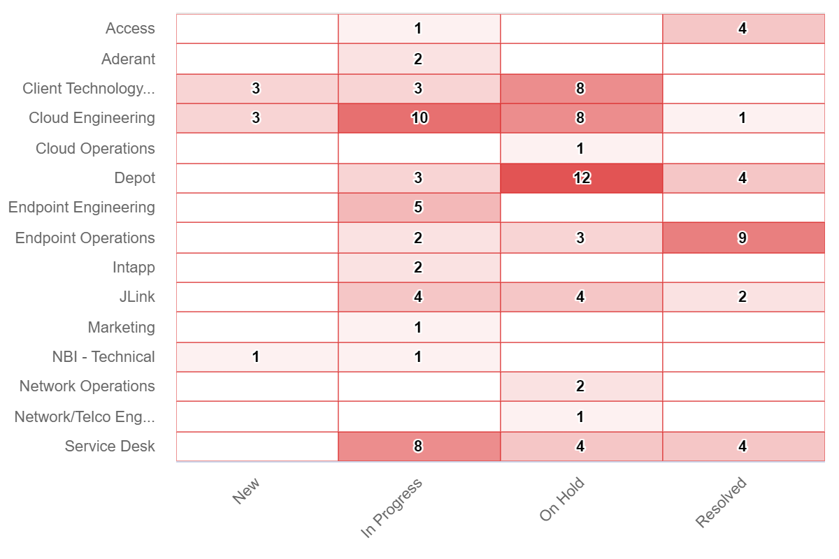
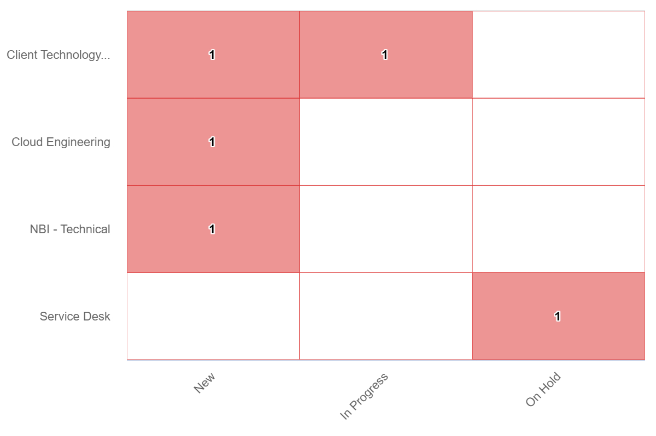
Incident Statistics
Open Incidents Older than 30 Days
Open Incidents not updated in last 30 days

Slide 12
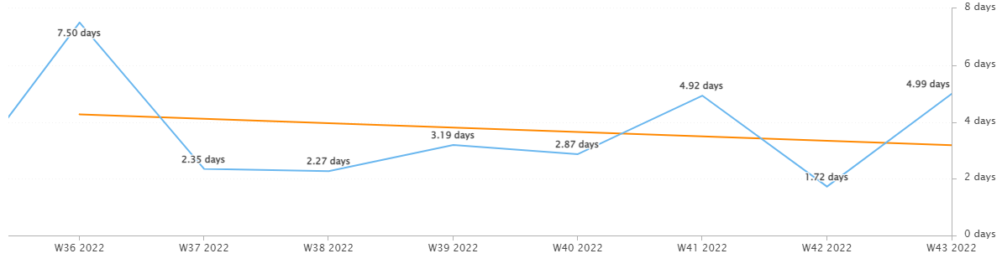
Incident Statistics
Average Resolution Time of All Resolved Incidents
The average resolution time trended downward across the month.

Slide 13
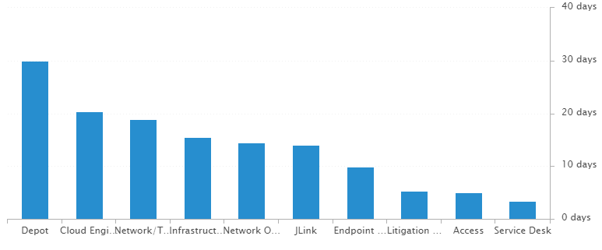
Incident Statistics
Average Resolution Time of Resolved Incidents, by Assignment Group

Slide 14
2022 SLA Goals & Actuals
Month | January | February | March | April | May | June | July | Aug | Sept | Oct | Nov | Dec
Goal | 90% | 90% | 90% | 90% | 90% | 90% | 90% | 90% | 90% | 90% | 90% | 90%
Actual | 88.8% | 88.1% | 92.7% | 92% | 90.6% | 93.9% | 91.6% | 91.2% | 90.7% | 89.9%
The Incident SLA goal in October was not met. A contributing factor may be the push to close out old incidents.

Slide 15
Problem Statistics
Open Problems
Problem | Date of most recent update | Assignment Group
PRB0010189 | 2022-10-12 | Cloud Engineering
PRB0010541 | 2022-07-20 | Security
PRB0010542 | 2022-07-27 | Intapp
PRB0010543 | 2022-10-26 | Cloud Engineering
PRB0010587 | 2022-10-12 | Cloud Engineering
PRB0010595 | 2022-08-31 | Telco Operations
PRB0010598 | 2022-11-01 | Cloud Engineering
PRB0010606 | 2022-10-21 | Endpoint Engineering
PRB0010617 | 2022-09-22 | Endpoint Operations
PRB0010633 | 2022-11-01 | Net/Telco Engineering
PRB0010634 | 2022-11-01 | Cloud Operations
PRB0010637 | 2022-11-01 | Net/Telco Engineering
PRB0010638 | 2022-10-28 | Infrastructure Engineering
PRB0010640 | 2022-11-01 | Cloud Engineering

Slide 16
Service Desk

Slide 17
Year over Year Quarterly Results
Total incident and call volume reduced in Q3 2022 over 2020 & 2021.

Slide 18
Key Call Statistics
Call volume rose to 3190 calls in October.
The goal was met, ending the month with 4.92%.
The abandonment rate monthly goal is 9%.
Notes:
~
There are several stats tracked for individual analysts as well as for the team and the org. Across the next few slides I’ll highlight some key statistics for the Service Desk team.

Slide 19
Key Call Statistics
The Service Desk met all 3 goals for each range. This correlates with the call volume and abandonment rates.
The goals for each time period:
70% of calls handled within 30 seconds.
75% of calls handled within 60 seconds.
80% of calls handled within 90 seconds.
Notes:
Over 75% of calls were handled within 30 seconds.
Over 80% were handled within 60 seconds.
Over 83% were handled within 90 seconds.
~
We track multiple metrics for calls handled- or how quickly a call is answered- within specific time periods. I’ve highlighted three here, calls handled within 30, 60, and 90 seconds.
The takeaway from these numbers should be that we are answering calls quickly which prevents calls from abandoning. Typically, we see the abandoned calls rise when these goals are not met- specifically the 60 seconds metric.

Slide 20
Key Call Statistics
The average speed to answer was 30 seconds which correlates with the trend of call volume & abandoned calls alongside the higher percentages for the calls handled within 30, 60, and 90 seconds.
Notes:
~
Average speed to answer is the average of how quickly all calls were answered by the Service Desk for the month.

Slide 21
Incident Statistics
Closed Monthly Data:
Incidents closed by SD: 2,820
Total Closed Incidents: 3,443
Closed by SD Percentage: 82%
Incidents closed by Service Desk, by Source:
Phone: 2,657
Email: 681
Self-Service: 80
Walk-in: 23
Notes:
~
The typical methods for contacting the Service Desk are phone and email, which explains the results in the incident source chart.
Self-Service we hope to expand over the next year and drive users towards generating their own incidents and using the JL Service Center more actively.
Walk-ins are low month-to-month with the split schedule for Return to Better. But from analyst feedback incidents for walk-ins are not being opened consistently. I aim to correct this over the rest of this year. I’ve also added it as a 2022 goal for each analyst within their reviews.

Slide 22
Incident Statistics
Top 5 Subcategories:
Microsoft Office (595)
Active Directory (454)
NetDocuments (390)
Power PDF (135)
Printer (113)
Top 5 Customers:
Emily Tewes (21)
Patty Williams Mears (21)
Barbara Bona (19)
Susan Vanderburgh (19)
Betty Arnold (17)
Average Incident/employee/month: 1.8
Average Incident/new hire/month: 1.7
Notes:
Across the month _had the highest number of related incidents.
Top 5 customers in the month are listed here.
Looking at the chart, we’re tracking incident volume per new-hire per month and comparing this to last year.

Slide 23
2021 Service Desk SLA Statistics
Survey Response Comment Highlights:
Dan – “IT responded promptly and was courteous.”
Stephane – “Thank you for all you do.”
“Thank you Neil for resolving the licensing issue with the copier.”
“I received immediate assistance and Taylor was very friendly.”
Taylor – “Quick response and I was logged on with relatively zero down-time.”
Noah – “Not only was the folder located and recovered but I was shown how we can now upload folders to NetDocs!”
Jaimi – “THE BEST EVER! Totally competent and very skilled and knowledgeable.”
September | Breached | Has not Breached | SLA %
Response | 94 | 2730 | 96.56%
Resolution | 38 | 2786 | 98.64%
Overall | 132 | 5516 | 97.61%
Response & Resolution SLA timers are determined by the Priority of the Incident.
Both Response and Resolution SLA reviewed on this slide are across all Priorities.
Notes:
Service level agreements/SLA
Response & Resolution SLA timers are determined by the Priority of the Incident.
Both Response and Resolution SLA reviewed on this slide are across all Priorities.
~ The Service Desk team is uniquely prepared to meet SLA goals. We generate incidents during calls, while emails generate their own incidents.

Slide 24
Knowledge Statistics
Top viewed articles, Self Service:
How to install a network printer
How do I contact the Service Desk?
How to configure JL email on your iOS device
Jackson Lewis Password Policy
Top viewed articles, IT:
Escalation paths and category guide
2Ring Dashboards
TeamViewer: Remote Control
Intapp Time Troubleshooting
Average Article rating: 4.65/5 Did you know?
1,924 searches were made from within the JL Service Center by 217 unique users.
These searches were across both Knowledge & Service Center.
Notes:
Knowledge within Service Now, is maintained by a few of us in the Service Desk team.
We evaluate resolved Incidents that have been flagged for knowledge.
On most of these flagged Incidents the fix or solution are not detailed by the escalated teams.
Knowledge is split into 2 sections. IT visible and Self-Service.
Please push your teams to write out the steps taken to resolve an issue, whenever possible.
This helps with knowledge but also helps when a user has a repeat issue, or the issue occurs for another user.
Reminder: your teams can generate their own knowledge articles. These will be used to increase our first call resolution and avoid escalating incidents.

Slide 25
Update & Reminder Highlights
Escalating Incidents: I know this is not being missed often but please remember to include needed information when escalating an incident.
I’ve heard from a few assignment groups recently about some various items missing in incidents when they receive them:
Doc IDs or document name (NetDocs or OneDrive), Screenshots of errors or text of errors, Troubleshooting steps taken
Holiday Schedule: Holiday schedule for 2023 has been added to the help desk calendar and invites sent as reminders for coverage.
Pexip: The Pexip project is moving forward to enable use of other meeting platforms on the Cisco Roomkits.
Egress POC: Please review Ryan’s email regarding Egress. A proof of concept is running for this tool that works alongside Exchange and Mimecast. Egress helps determine risk in an email being sent.
Office Closures: Both Honolulu and Memphis officially close on October 31st. Both offices we have access to until the end of November, so that various business services teams can turn down these sites.
Honolulu users will be departing, while a mix of departures and transfers are happening for Memphis.
Password Resets: A quick reminder to follow the guidance here for resetting passwords.
Password Policy: Our password policy is here and you may link this to users if they request information on the password policy.
Remember that we may reset passwords any time from Active Directory Users & Computers, while the users may not change their password within 30 days of setting their password.
Notes:
Some highlights from the month’s U&R emails are listed here.
One to two emails are sent a week to the Service Desk reminding them, or updating them on, changes to existing workflows or policies. Quick notes sent via Teams are also rolled up into these emails to be sure that these points are not missed. All U&R emails are listed in Confluence for reference by other teams.

Slide 26
Technology Operations

Slide 27
Escalation Status

Slide 28
Escalation Baselines

Slide 29
Logic Monitor Alerts
Critical Alerts:
Extending the daily SDT for clocktimizer
Switches – Stack State and Idle interval (Health Probe Failed)
Error Alerts:
1223 alerts CPU Spikes
Vm-caris-col-01 ( Varonis Azure VM)
vm-eus2-mat02 ( Matallion Azure VM)
Azure Domain Controllers
JL-SN-MID-E01 ( Service Now discovery Server)
JLNOVITEK-E01 (Novitek Server)
485 Alerts on Silver Peaks
455 Alerts on Reboots ( Servers failed to be placed I nSDT)

Slide 30
Resource Uptime
Resource | August | September | October
Aderant | 100% | 99.936% | 99.992%
Intapp Walls | 100% | 100% | 100%
JL - Home | 99.503% | 44.393% | 99.934%
JLink | 99.996% | 99.922% | 99.993%
NBI | 99.525% | 44.427% | 99.938%
Payments Credit Card | 99.957% | 100% | 100%
Dashboard | 100% | 100% | 99.998%
Biscom | 99.997% | 100% | 100%
Citrix | 100% | 99.928% | 99.987%
VPN East | 99.997% | 100% | 100%
VPN West | 99.73% | 99.973% | 99.982%
Logic Monitor Collector Polling
More or less similar to the previous month.

Slide 31
Endpoint Engineering

Slide 32
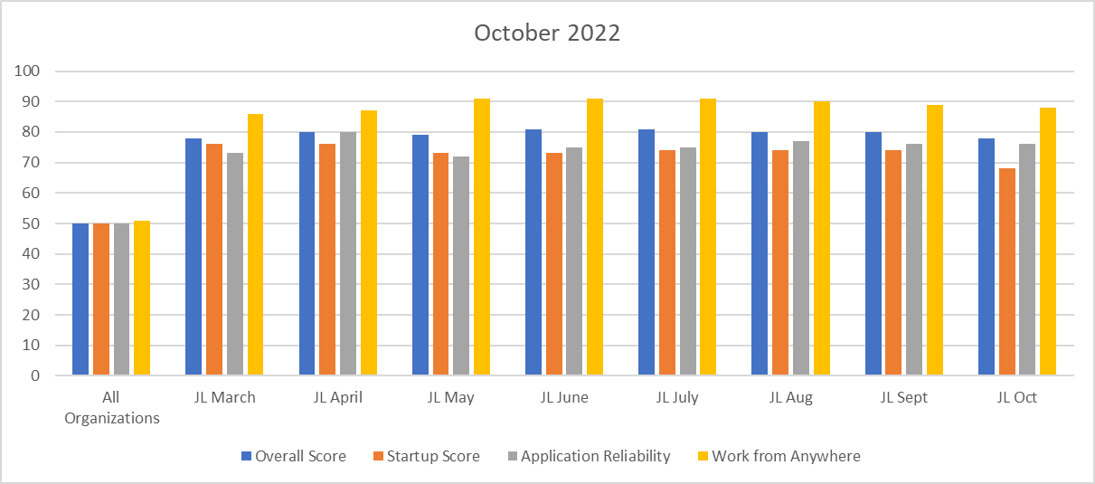
Endpoint Analytics
Overall score fell one point to 78 from September primarily due to remaining 21H2s Feature Update deployed into production.
App Reliability score of 76 due to staying current with updates and app versions of our base image.
Work From Anywhere score of 86 due to our SCCM CMG still out of service. Currently working with MS to resolve.

Slide 33
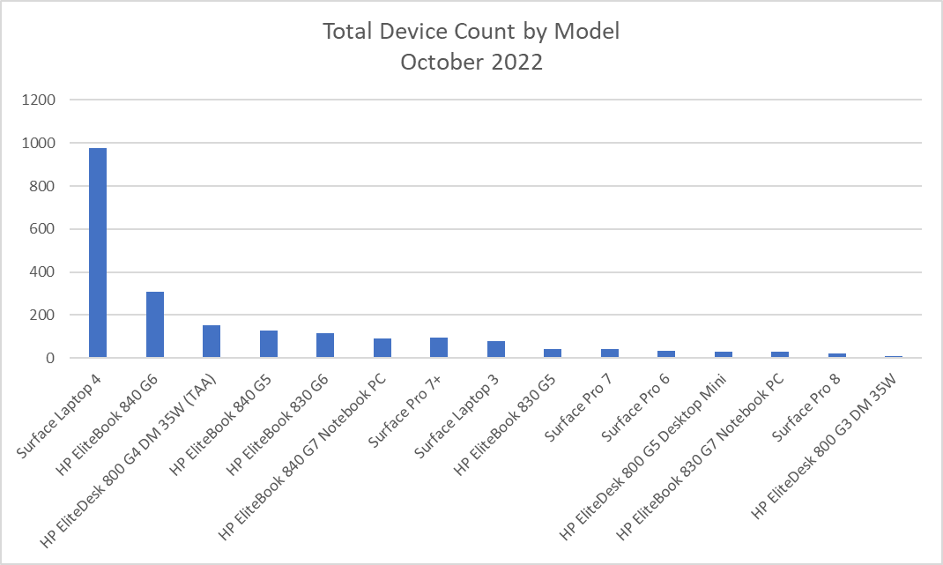
Endpoint Model Inventory
Continuing the trend of replacing our hardware with Microsoft products, giving us increased performance and reliability.
975 total Surface Laptop 4s – Best overall performer
13 Remaining Surface Pro 5s - Worst overall performer

Slide 34
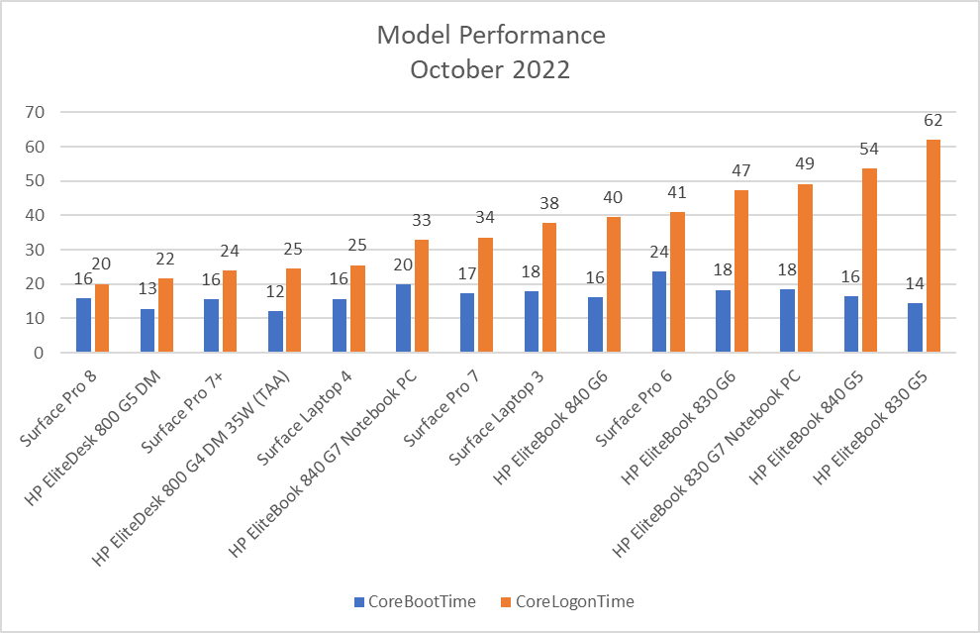
Endpoint Model Performance
Continuing to phase out older models with our latest models, Surface Pro 7+, Surface Pro 8 and Surface Laptop 4 allowing users to boot quicker, sign-in quicker and increase their productivity.

Slide 35
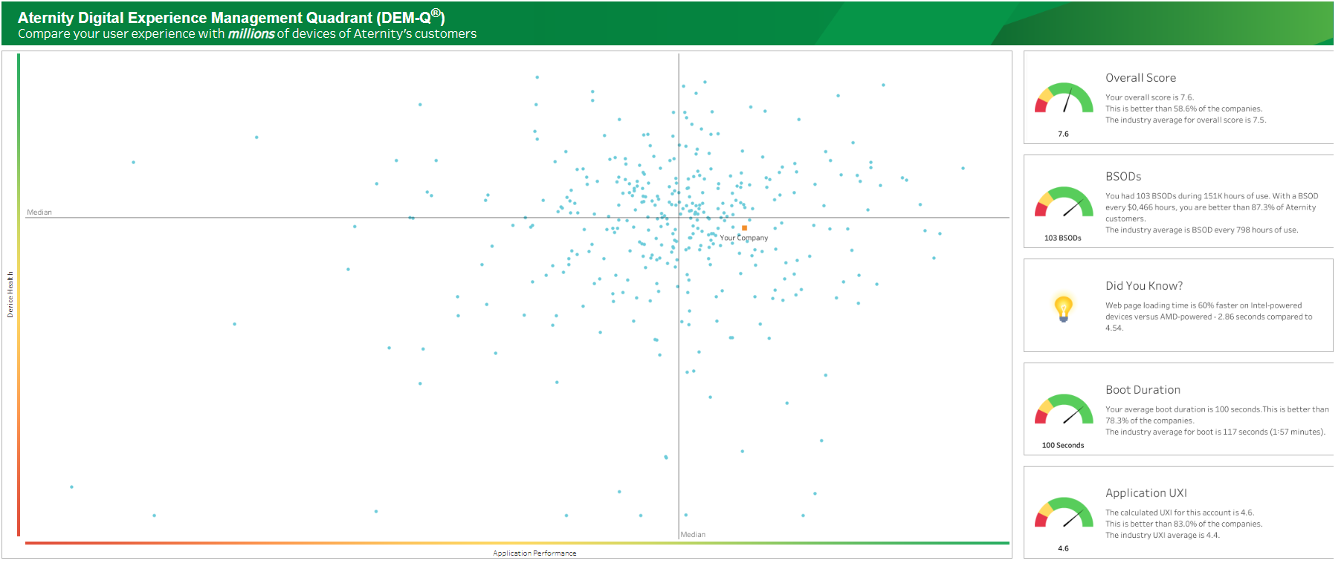
Aternity DEM-Q Performance
DEM-Q fell 4 points to 7.6 from September. We expect this number to rise back to the 8s once WUfB production ring for October fully reach production.
Boot duration fell to by 2 seconds to 100sec from September
App UXI is still holding at 4.6, and increased to be better only than 83.0% of companies.

